Slide 1
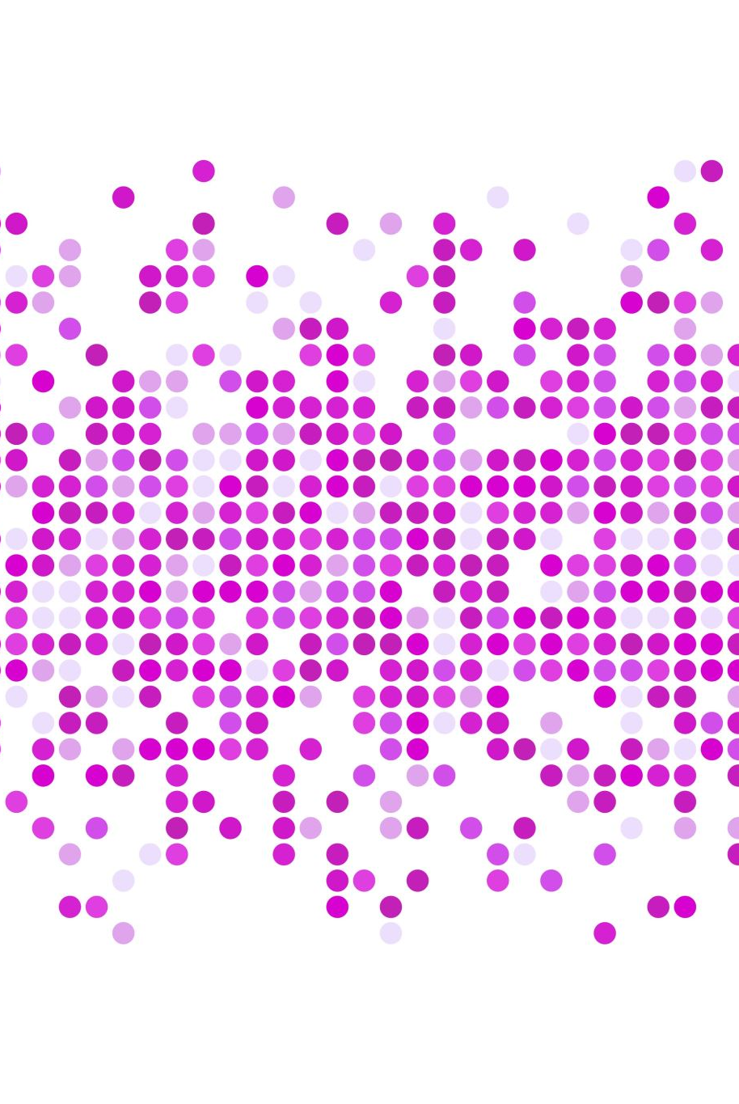
Unsupervised Learning
Clustering

Slide 2
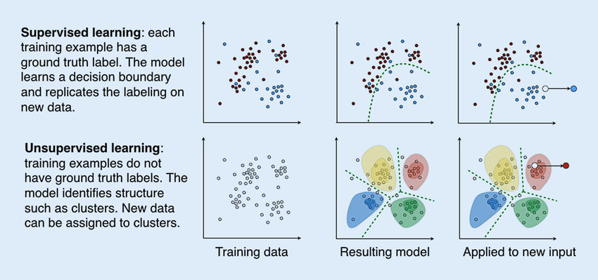
Unsupervised vs Supervised
Machine learning: from radiomics to discovery and routine
Georg Langs et al (2018)

Slide 3
Clustering
Clustering belongs to the group of unsupervised machine learning techniques
No label data is necessary
Can be used to construct labels for the data
Often performed after dimensional reduction
Very dependent of the nature of the data

Slide 4
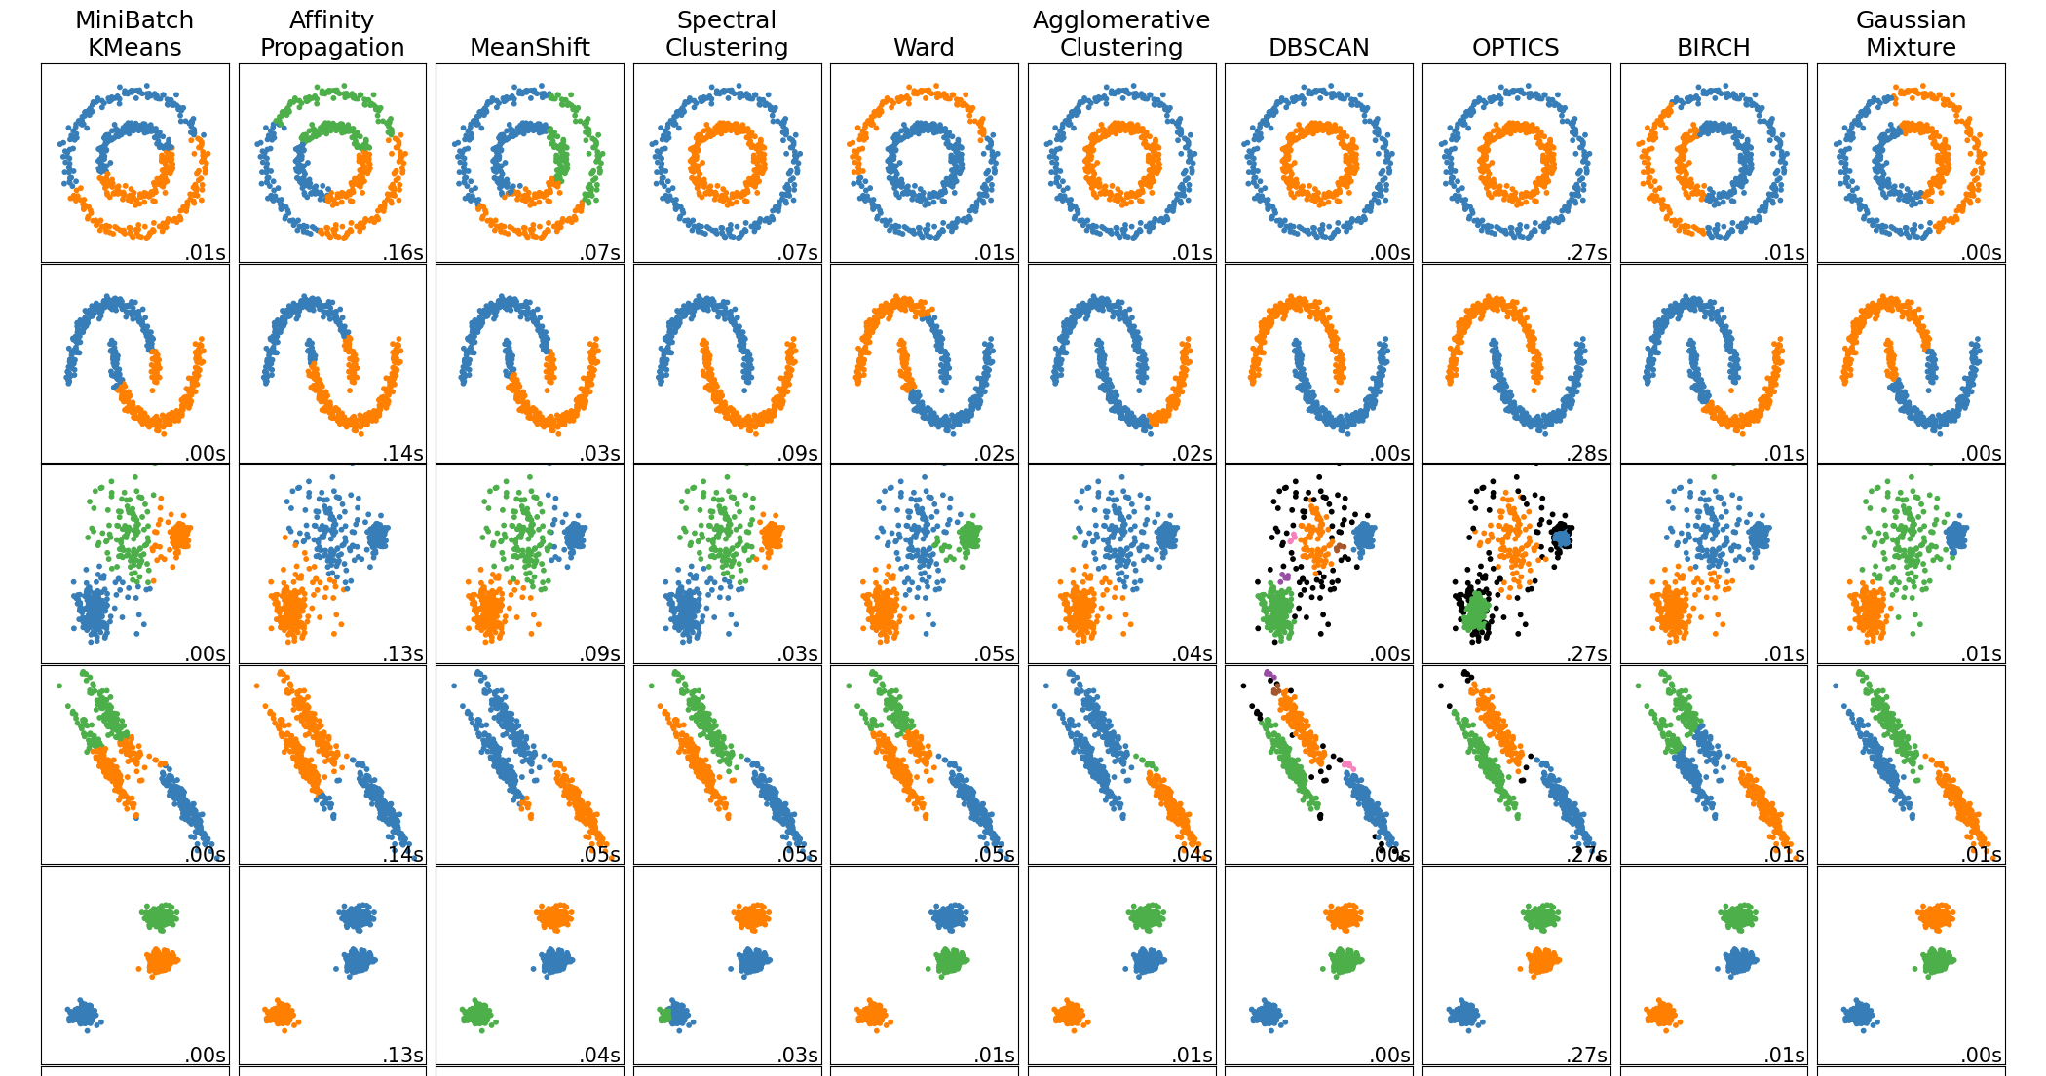
Sklearn Example
Notes:
Currently a lot of different algorithm are available for clustering.
MiniBarch Kmeans: Same as k-means but for massive datasets instead of using the whole dataset for each iteration, only a mini batch is used for centroid detection
Affinity Propagation: Not necessary to determine the number of clusters in advance, its a message sending algorithm by informing about the attractiveness of each datapoint to the sender

Slide 5
K-mEans Clustering
Own Dummy Dataset using Sklearn make_blobs; using euclidean distance!
https://ai.plainenglish.io/understanding-k-means-clustering-hands-on-visual-approach-c2dc46f0ed18
Notes:
K-means is a centroid-based clustering algorithm, where we calculate the distance between each data point and a centroid to assign it to a cluster. The goal is to identify the K number of groups in the dataset.
“K-means clustering is a method of vector quantization, originally from signal processing, that aims to partition n observations into k clusters in which each observation belongs to the cluster with the nearest mean, serving as a prototype of the cluster.” – Source
It is an iterative process of assigning each data point to the groups and slowly data points get clustered based on similar features. The objective is to minimize the sum of distances between the data points and the cluster centroid, to identify the correct group each data point should belong to.
Here, we divide a data space into K clusters and assign a mean value to each. The data points are placed in the clusters closest to the mean value of that cluster. There are several distance metrics available that can be used to calculate the distance.

Slide 6
Advantages and Disadvantages of K-means
Advantages
Easy to implement
Relatively fast
Scales easily to large data (but, dimensionality problem)
Easy to interpret
Disadvantages
Assumes spherical representation of the data
Scaling is necessary
Outlier sensitive
You have to choose the number of clusters

Slide 7
DB-Scan
Density-based algorithm
How does it work:
Random start
All points within a window are neighbours of the point/cluster
First point is either start of the cluster of outlier (if no neighboring points are nearby)
Slide along all points
https://www.digitalvidya.com/blog/the-top-5-clustering-algorithms-data-scientists-should-know/
Notes:
https://www.digitalvidya.com/blog/the-top-5-clustering-algorithms-data-scientists-should-know/

Slide 8
Advantages and Disadvantages
Advantages:
Handles irregular shape
Can predict outliers (often marked as -1)
No predetermined number of clusters
Disadvantages:
Density drop to detect cluster borders
Scaling is necessary
Dimensional Reduction

Slide 9
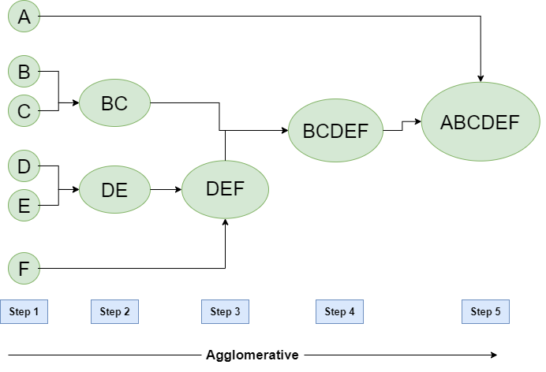
Hierachical Clustering
Distance-based metric
1st: Consider each data point as clusters
2nd: Merge points based on distance
3nd: Nearest clusters are merged
4nd: Repeat process/only one cluster left
Distances: Euclidean Distance (Most commonly used), 1- Correlation (Dissimilarity), Cosine Distance (NLP)

Slide 10

Calculate Euklidean Distance
a = $\begin{matrix}3 \\ 4\end{matrix}$ b = $\begin{matrix}0 \\ 6\end{matrix}$
How to calculate the euclidean distance between the two vectors?
Notes:
First diference between both vectors:
3-0 und 4-6 --> (3, -2) → squared product (3^2 + -2^2) 9 + 4 → sqrt (13) → 3.641

Slide 11
Advantages and Disadvantages of hierachical Clustering
Advantages
Easy to understand
Easy to implement
No need to specify number of clusters for the algorithm
Dendogram for clear visualization/helps to decide cluster number based on distance
Can support categorical variables
Disadvantages
Slow
Algorithm cannot undo merging procedure
Notes:
Outliere usually get only added after all other points were already merged, so usually the last step is outlier addition
When to use? Especially if you want ot get the most similar points in one cluster, if you need to have a look at the data clustering with different resolutions
Faster option is an algoirithm called birch

